Slide 1
Deploy Azure Data Solutions
with Bicep and Azure DevOps or GitHub Actions

Slide 2

Who am I ?

Slide 3
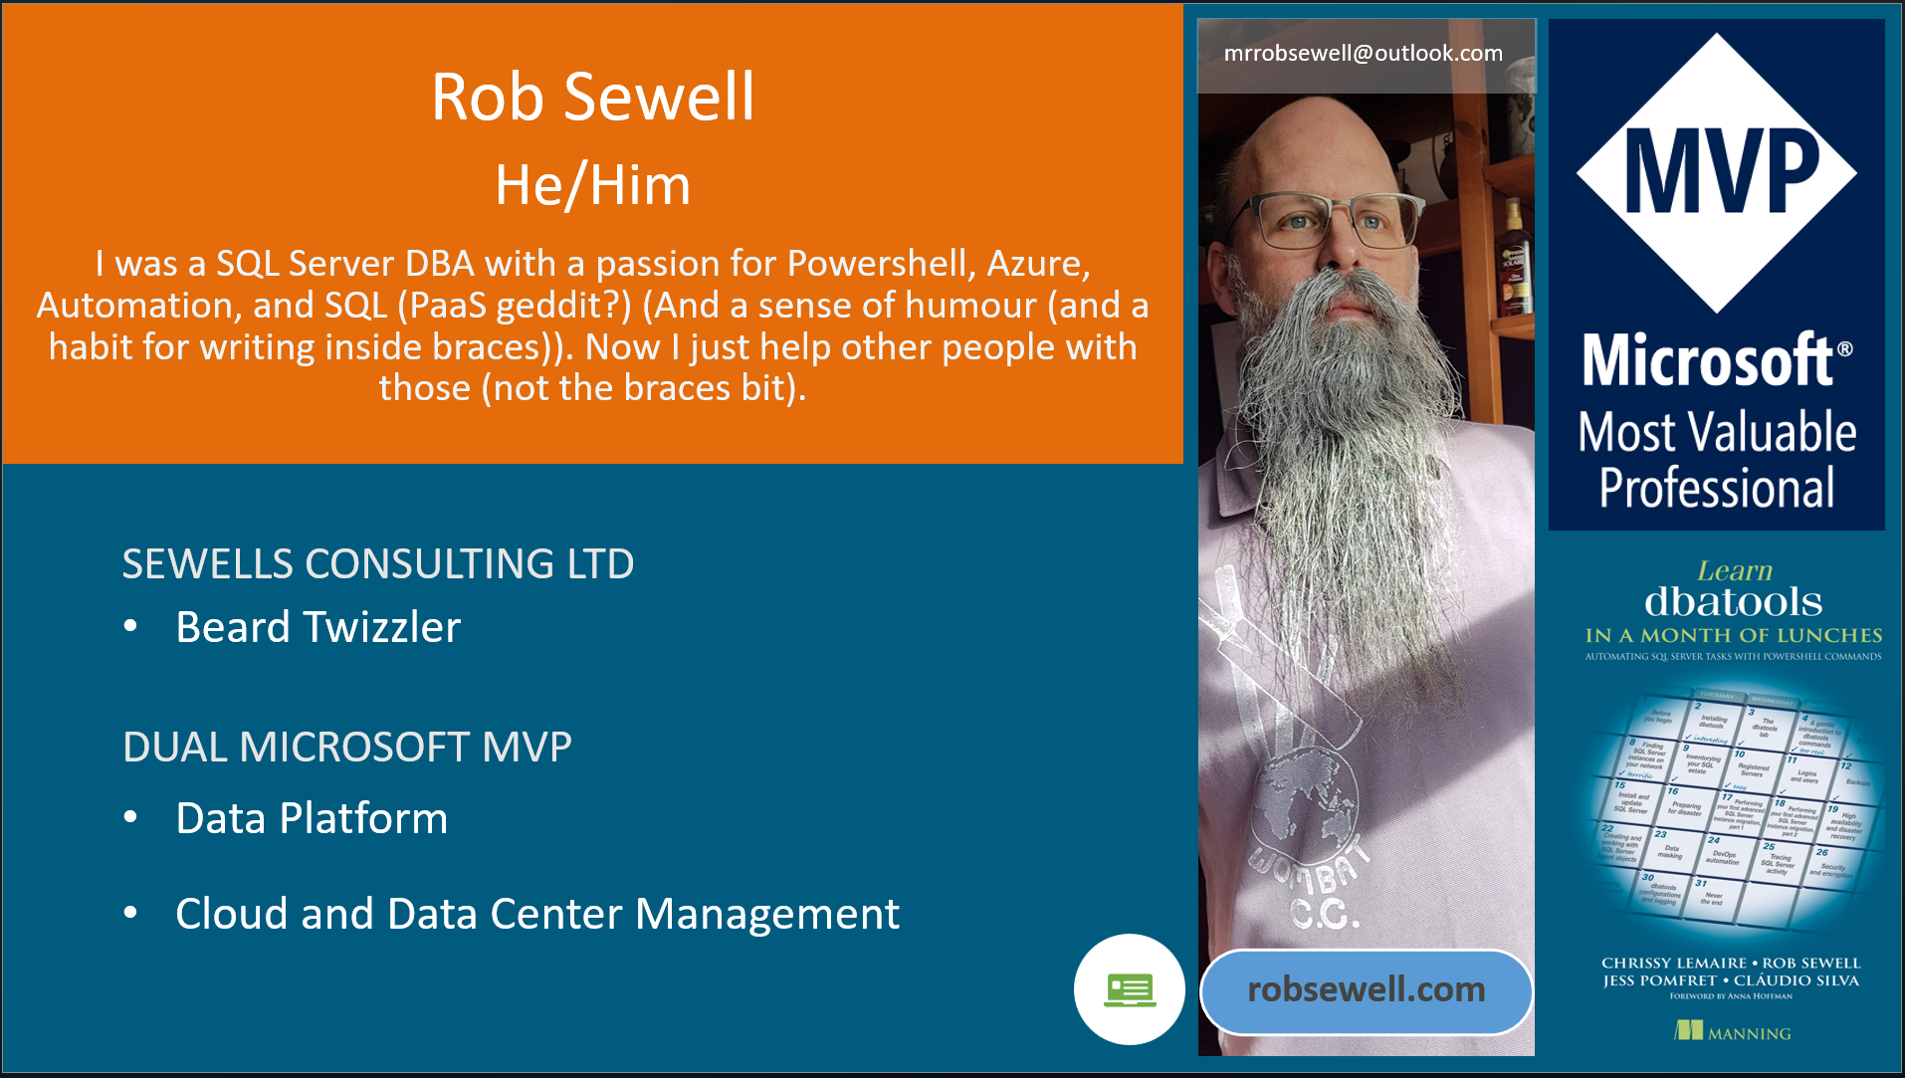

Slide 4

Why Infrastructure as Code?

Slide 5

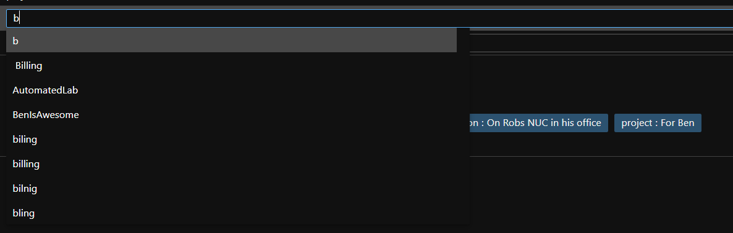
We make mistakes
Unfortunately, we are fallible
We can’t do the same thing 100 times reliably
Photo by Rob Curran on Unsplash

Slide 6

Computers will do the same thing everytime
Photo by Taylor Vick on Unsplash

Slide 7
But there is more
Auditing
History of changes – (Troubleshooting? What has changed?)
Enforced property setting – No Public Endpoints on Storage, Naming conventions
Testing
Disaster Recovery
Repeatability
Speed
Documentation

Slide 8
Bicep is a Domain Specific Language (DSL) for deploying Azure resources declaratively

Slide 9
Why use Bicep and not ARM Templates ?
Easier to read
Easier to Develop
Fantastic VS Code Resources
Modules
(It’s not JSON)

Slide 10
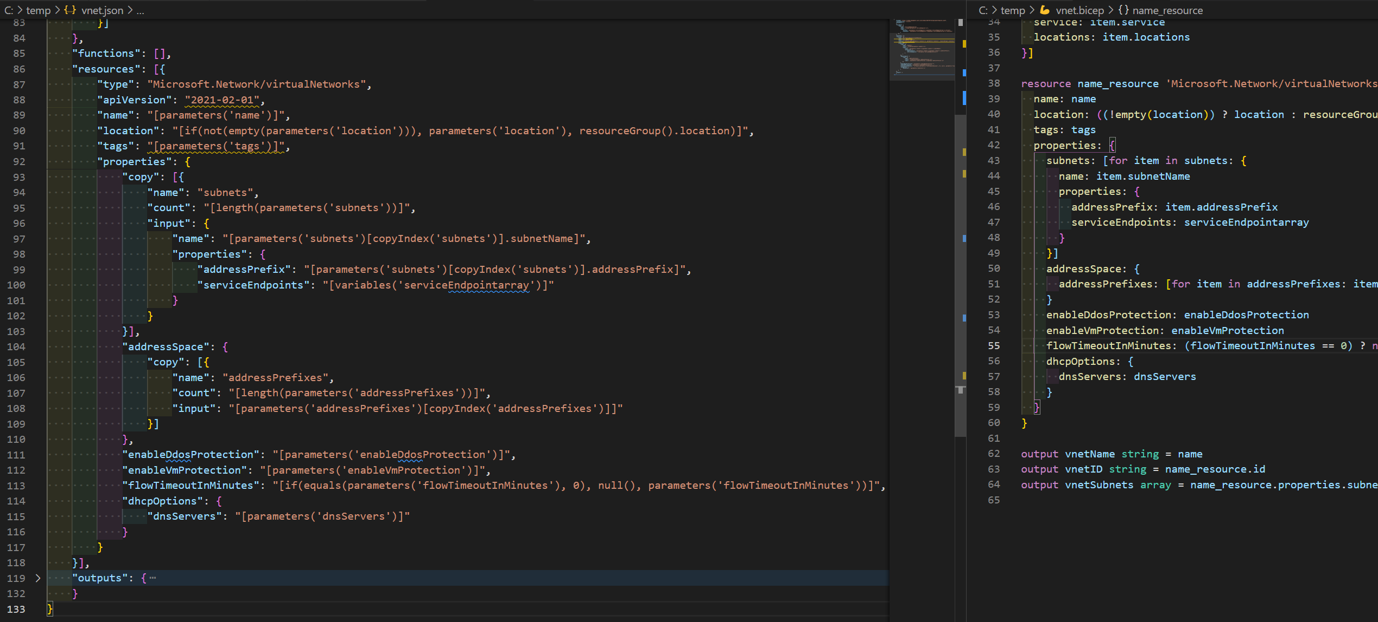

Slide 11
resource name_resource 'Microsoft.Network/virtualNetworks@2021-02-01' = {
name: name
"resources": [{
"type": "Microsoft.Network/virtualNetworks",
"apiVersion": "2021-02-01",
"name": "[parameters('name')]",

Slide 12
"properties": {
"copy": [{
"name": "subnets",
"count": "[length(parameters('subnets'))]",
"input": {
"name": "[parameters('subnets')[copyIndex('subnets')].subnetName]",
"properties": {
"addressPrefix": "[parameters('subnets')[copyIndex('subnets')].addressPrefix]",
"serviceEndpoints": "[variables('serviceEndpointarray')]"
}
}
}],

Slide 13
properties: {
subnets: [for item in subnets: {
name: item.subnetName
properties: {
addressPrefix: item.addressPrefix
serviceEndpoints: serviceEndpointarray
}
}]

Slide 14
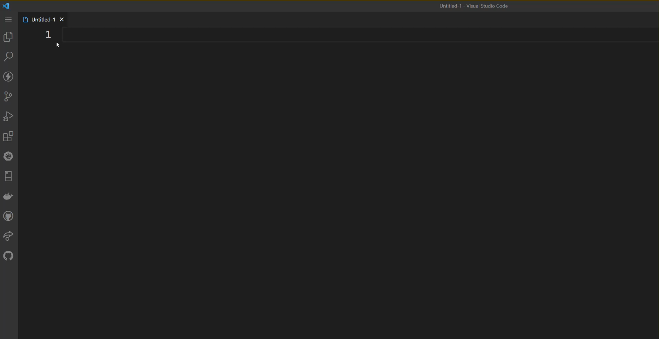

Slide 16
Install the tooling
choco install bicep –y
https://chocolatey.org/install
Other methods available here
https://docs.microsoft.com/en-us/azure/azure-resource-manager/bicep/install

Slide 17
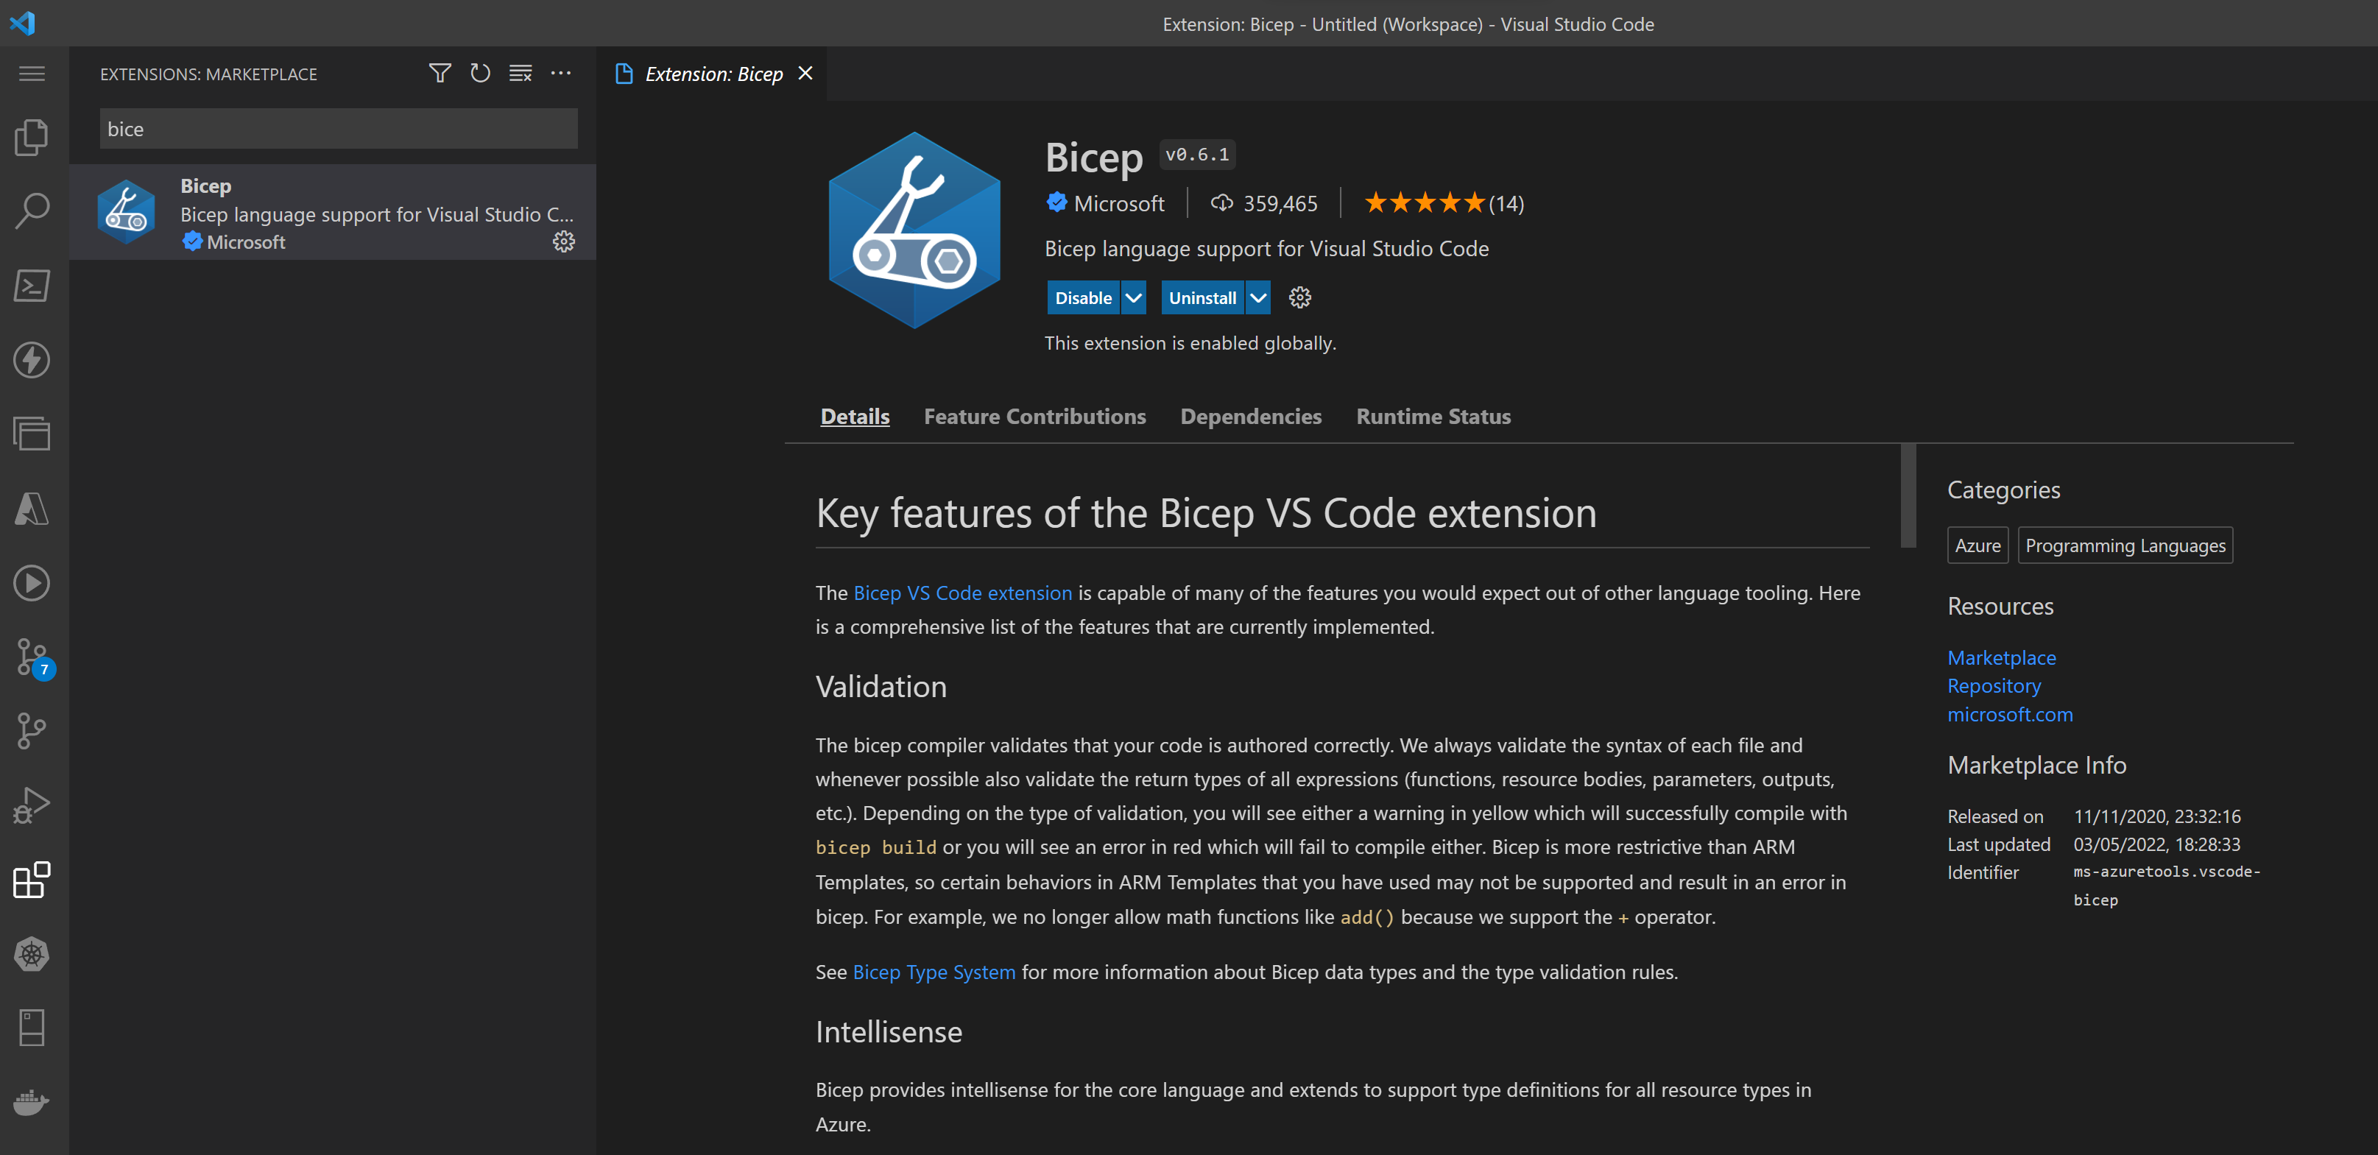
Install the tooling

Slide 18













































































Develop Bicep
Compile into ARM Template
Azure Resource Manager

Slide 19
Deployment – az CLI
# Create a Resource Group
az group create --name beards --location uksouth
# Deploy the Bicep file
az deployment group create --resource-group beards --template-file MyBeard.bicep

Slide 20
Deployment – Azure PowerShell
# Create a Resource Group
New-AzResourceGroup -Name Beard -Location uksouth
# Deploy the Bicep file
New-AzResourceGroupDeployment -ResourceGroupName Beard -TemplateFile myBeard.bicep

Slide 21


